Slide 1
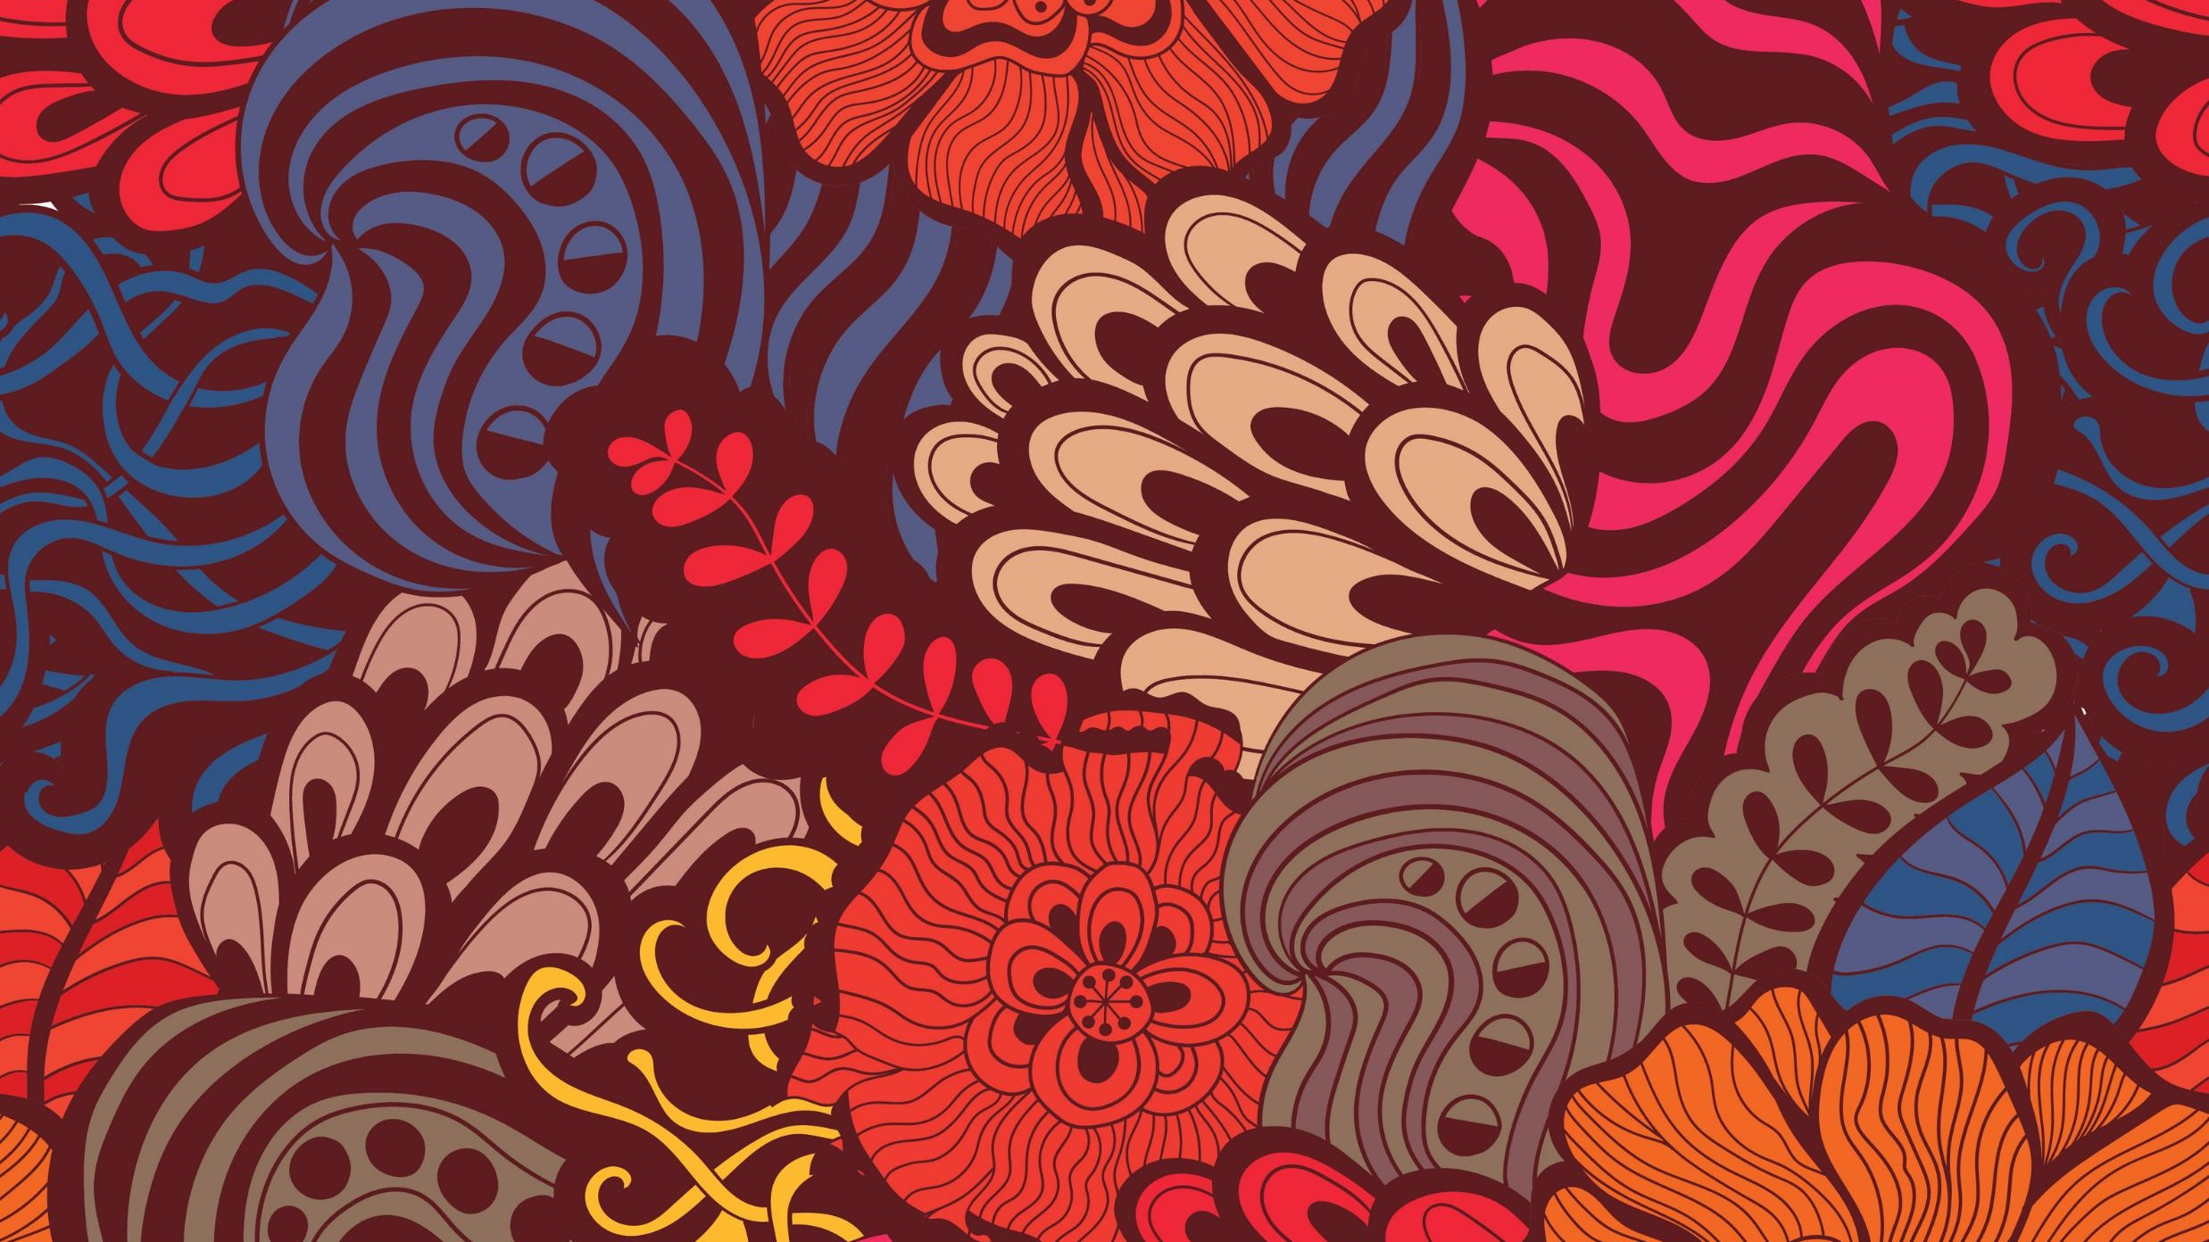
Neural Style Transfer
AIvengers

Slide 2
Problem Statement
Challenge 1-Developa codebase to perform Neural Style Transfer given a content image and a style image
•Challenge 2–Design web-application to have the functionality, upload own style and content images using Flask or FastAPI
•Challenge 3–Deploy the web-application onto a cloud platform and perform the style transfer as an on-demand function (For example -AWS Lambda function)

Slide 3
Approach
Framework used – PyTorch
Network – pretrained VGG19
Reported Results –
content_layers_default = ['conv_3', 'conv_4’]
style_layers_default = ['conv_1', 'conv_2', 'conv_3', 'conv_4', 'conv_5’]

Slide 4
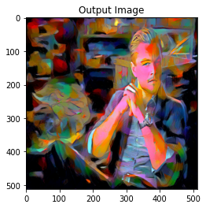
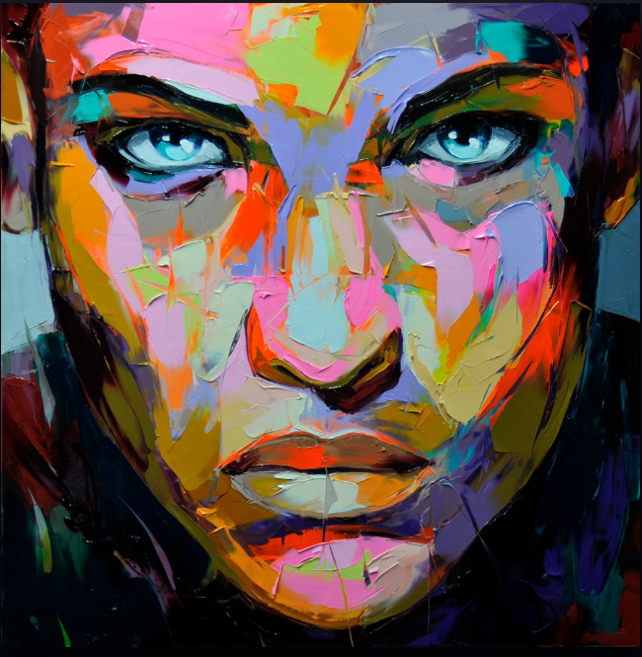
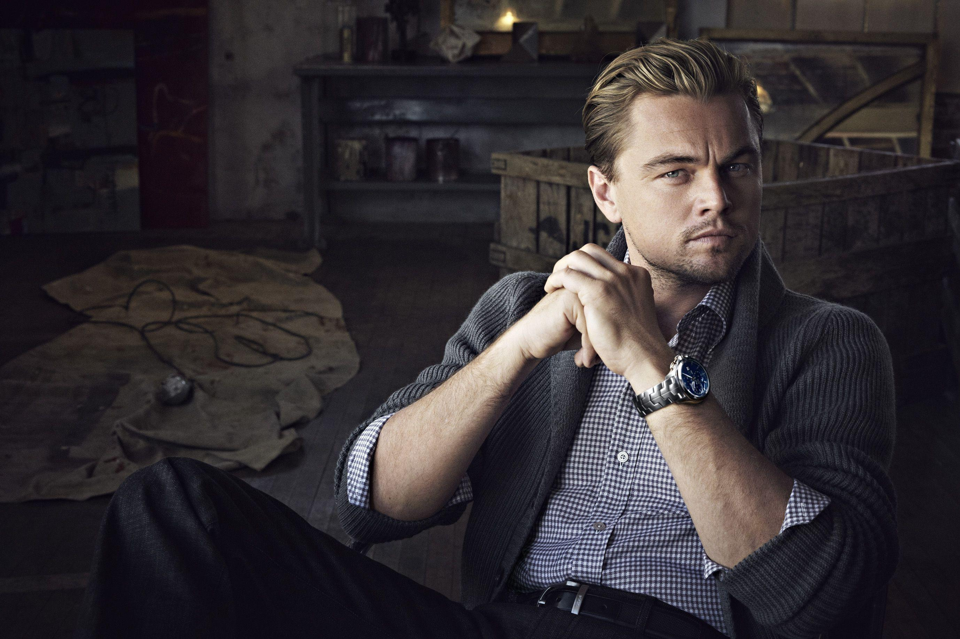
Results - 1
+

Slide 5
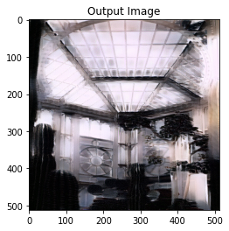
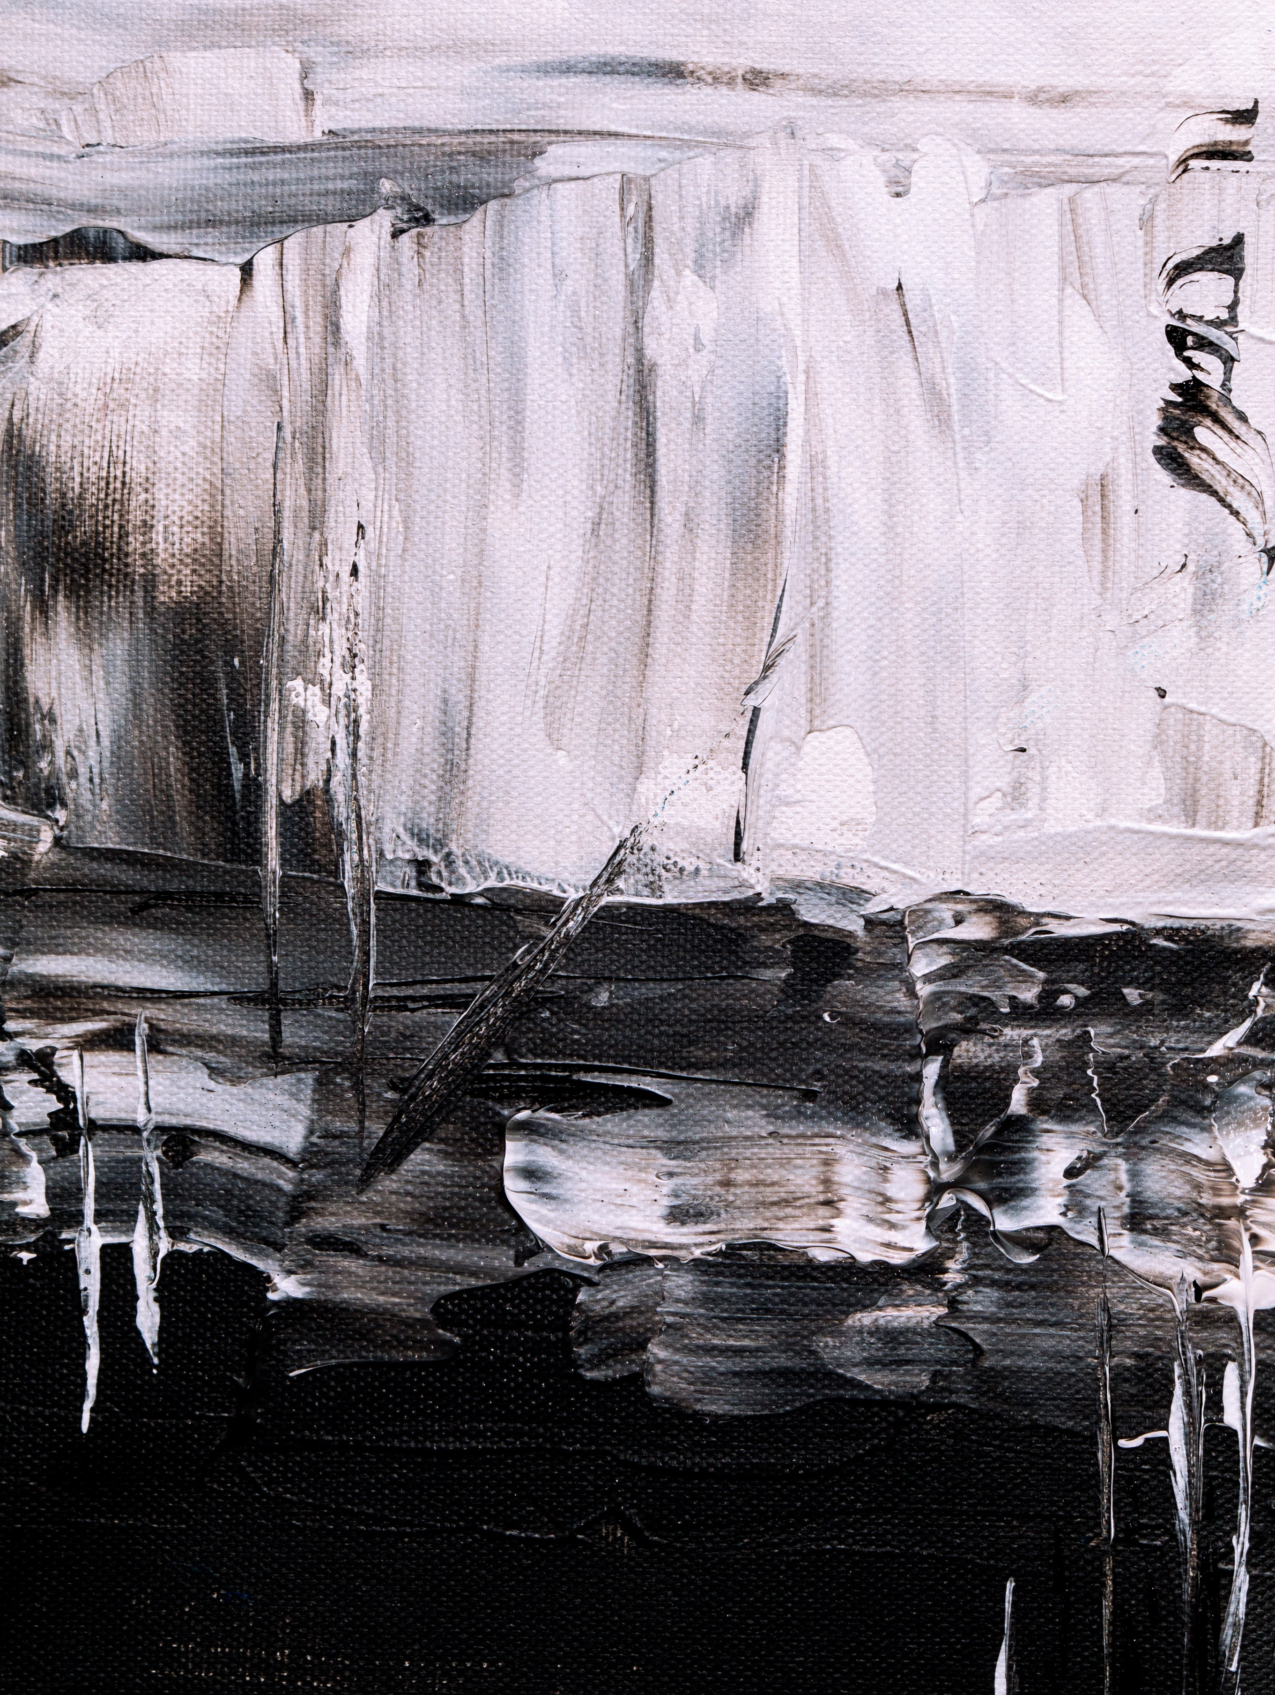

Results - 2
+

Slide 6
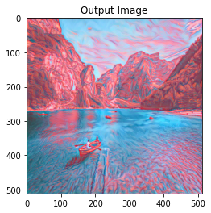
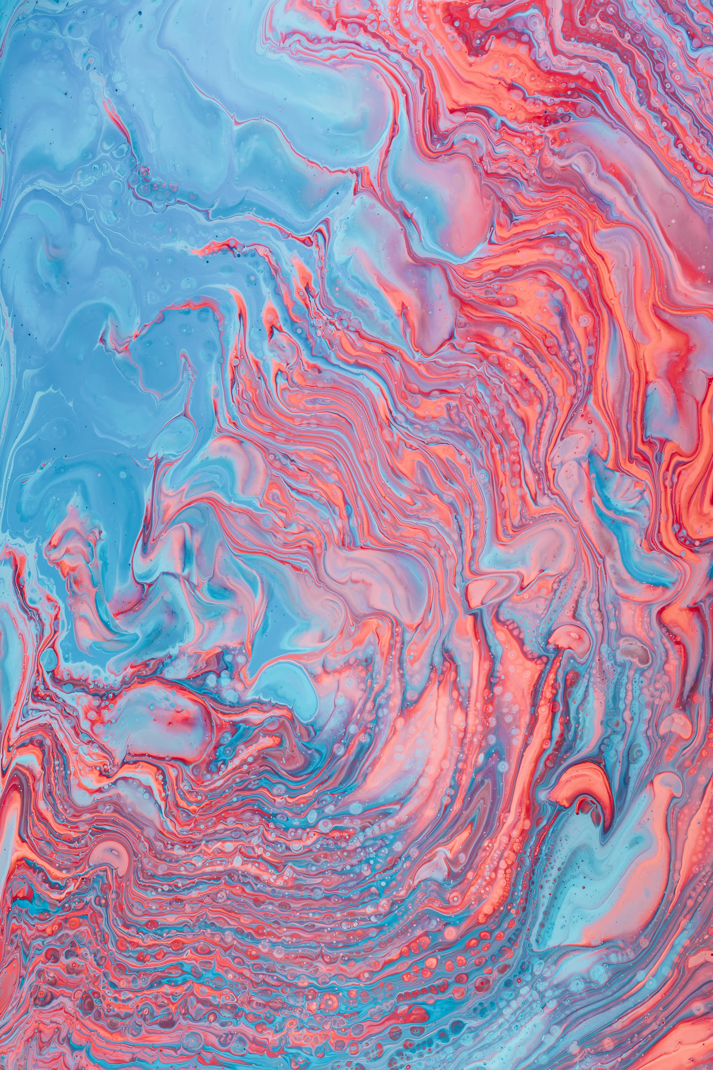
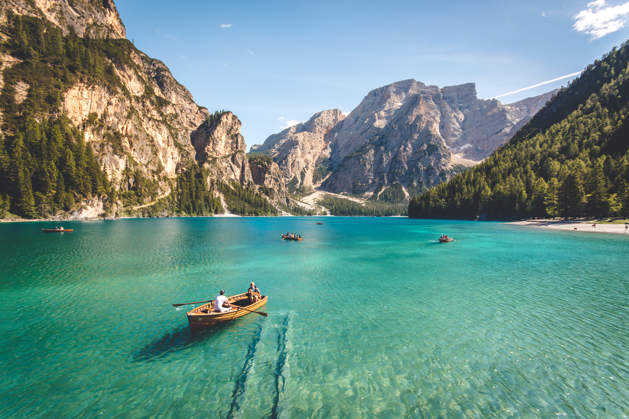
Results – 3
+

Slide 7
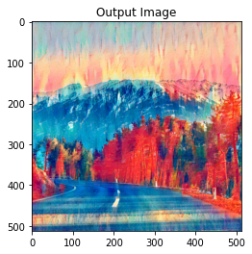
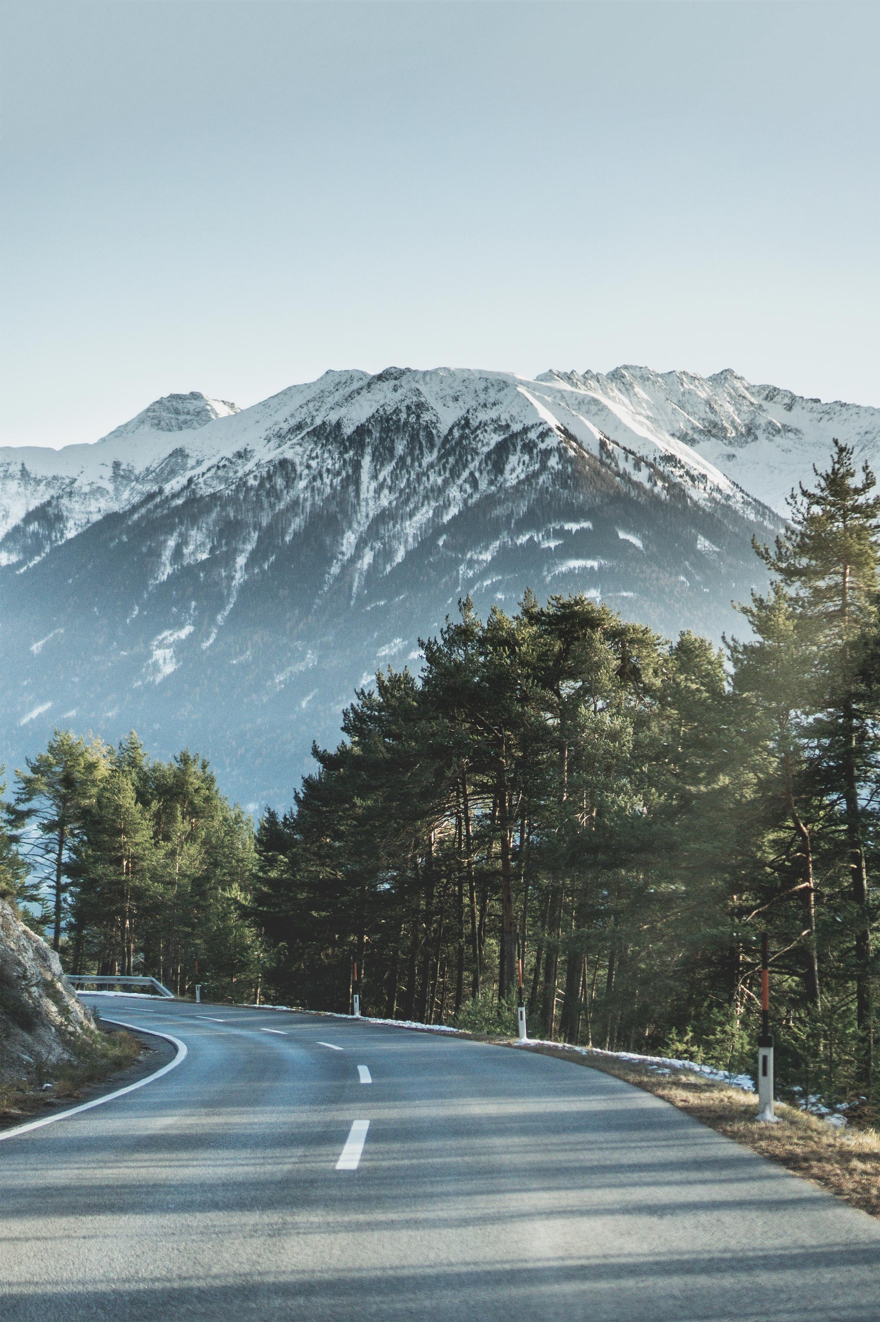
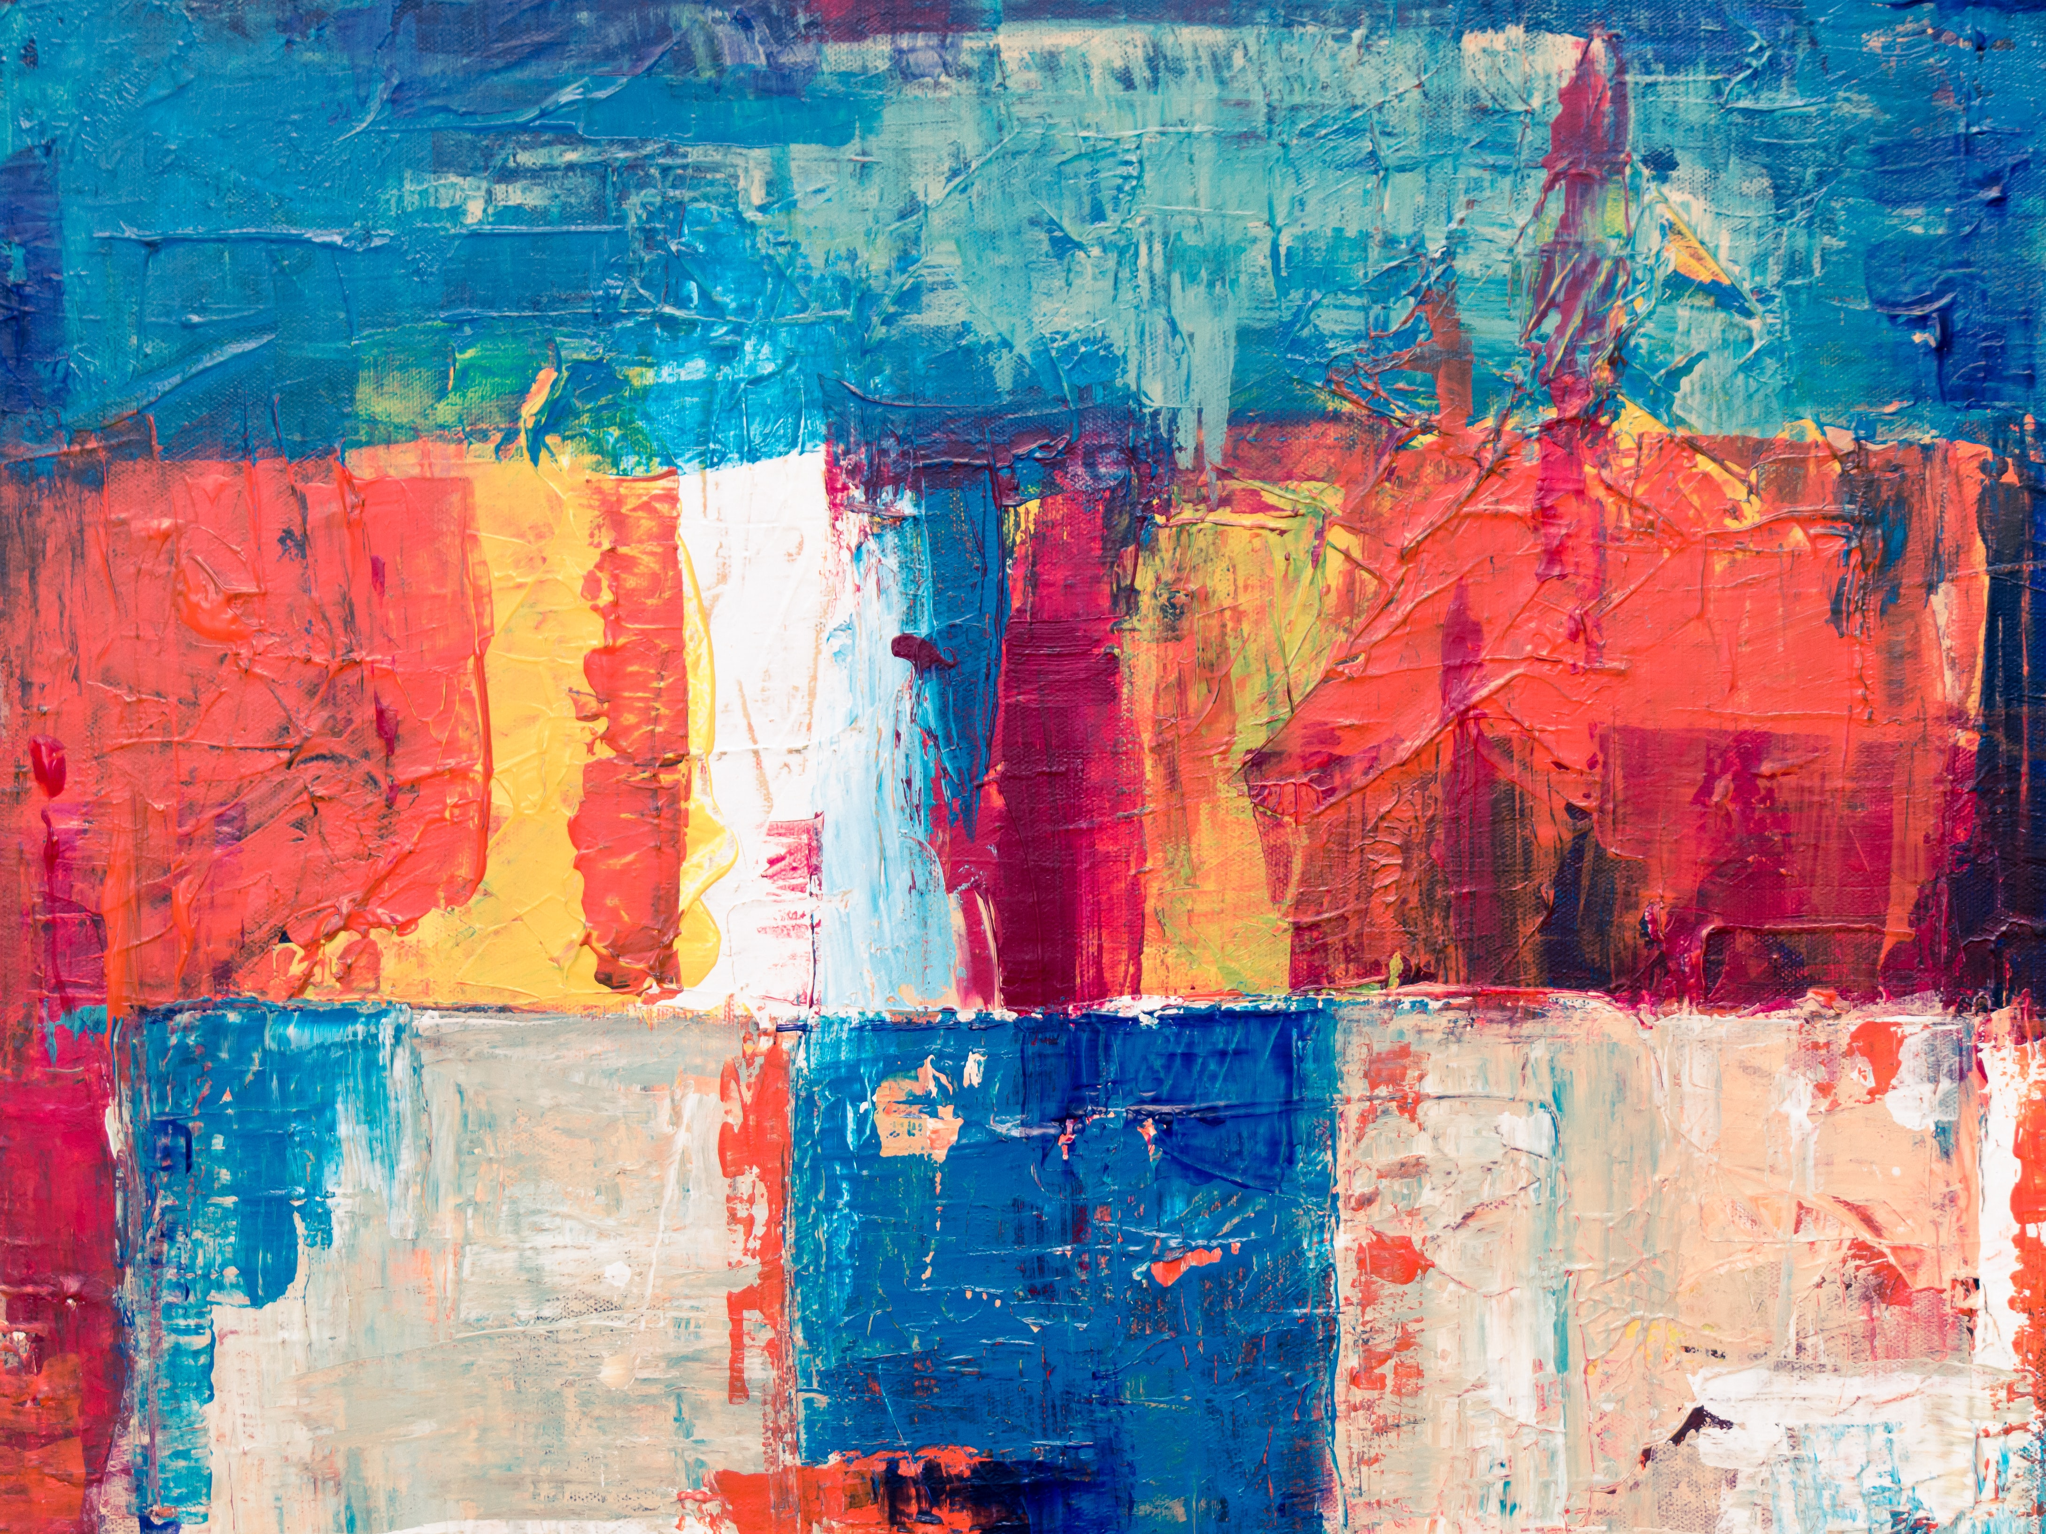
Results – 4
+

Slide 8
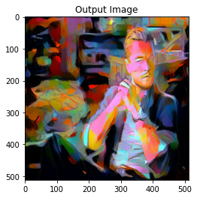
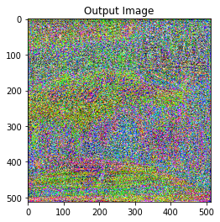
What we Tried – L2 vs Smooth L1
L2 Loss
Smooth L1 Loss

Slide 9
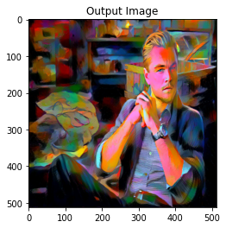
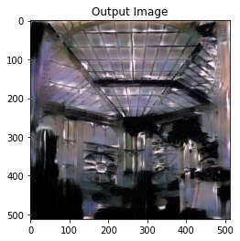
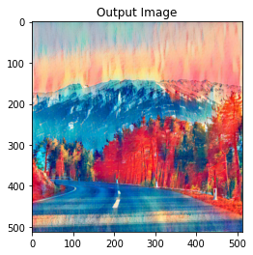
What we Tried – Adding more content Layers
L2 Loss
Content -'conv_3’, 'conv_4'
L2 Loss
Content - 'conv_1', 'conv_2’,
'conv_3', 'conv_4', 'conv_5'

Slide 10
Lossses

Slide 11
Thank you

